Slide 1
Virtual Base Classes in C++

Slide 2
Virtual Inheritance and Need for Virtual base classes
Class A
If two classes B and C inherits from class A and class D inherits from both classes B and C, there will be two copies of members of class A in D. One through class C and the other through class B
When data members of A are accessed by an object of D, an ambiguity arises to which data/function member would be called, the one inherited through C or B. This confuses the compiler and it shows an error.
Virtual Inheritance is a technique in C++ that ensures only one copy of base class’ data and function members are inherited by the grandchild derived class.
Class B
Class C
Class D

Slide 3
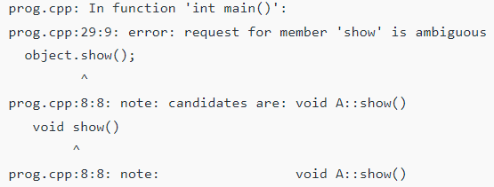
Consider in the above example that the class A contains a member function void show(). If I create an object ‘object’ of class D and try to access the member function show() through the object of class A as ‘object.show()’. The compiler becomes confused and shows the following error.

Slide 4
Virtual base class
To resolve the stated issue when class A is inherited by classes B and C it is declared virtual by placing the keyword virtual as:
class B: public virtual A{
};
or
class C: virtual public A{
};
Now only one copy data/function members will be copied to class B and C. Class A becomes virtual base class.

Slide 5
Virtual Base Class
Virtual base classes offer a way to save space and avoid ambiguities in class hierarchies that use multiple inheritance.
When a base class is specified as virtual base, it can act as an indirect base more than once without duplication of it’s data members.
A single copy of it’s data members are shared by all the classes that uses this virtual base.

Slide 6
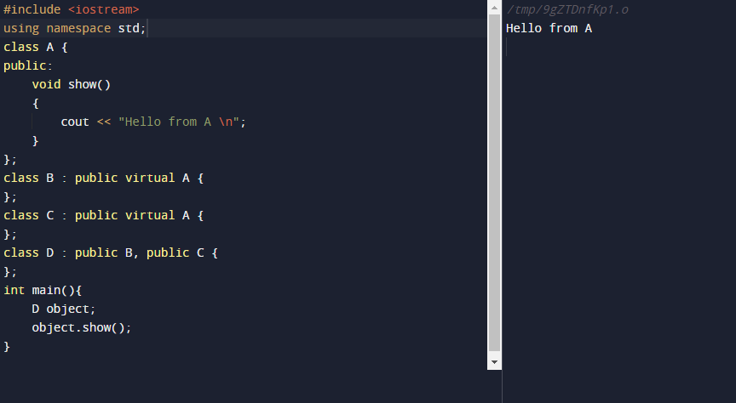

Slide 7
THANK YOU

